Slide 1


DEPARTMENT OF COMPUTER SCIENCE AND ENGINEERING CMR TECHNICAL CAMPUS (2020-2024) A Mini Project On
SUPER MARKET BILLING SYSTEM USING WEBCAM
Batch No. 16
By
Shaik Mohammed Altaf 217R5A0522
Under the Guidance of
A. Ganapathi
(Assistant Professor)
Ammannagari Vidhathri 207R1A05J6
Maddela Anuroop 217R5A0520

Slide 2
CONTENTS
Abstract
Existing System
Disadvantages of Existing System
Proposed System
Advantages of Proposed System
Hardware and Software requirements
Novelty of the project
Architecture
Modules
UML diagram
Sample code
Results
Conclusion
Future Scope
References
Github Link

Slide 3
ABSTRACT
If a consumer would like to buy something at a shopping mall, consumers need to take the particular items from the display shelf and then queue up and wait for their turn to make payment.
The time taken for consumers to wait for the consumers in front of the queue to scan every item and making payment will definitely take plenty of time.
While doing survey we found that most of the people prefer to leave the shopping mall instead of waiting in long queues to buy a few products.
To try to solve the problems previously identified, recent years have seen the appearance of several technological solutions for hypermarket assistance. All such solutions share the same objectives to save consumers.

Slide 4

EXISTING SYSTEM
Bar code scanning machines are used with a technology called LMLL(Laser Method Laser Light), which also requires a person to scan.
The possibility of misreads, which can lead to data errors. And even there is a need for a clear line of sight between the barcode and the scanner.
Even these machines are very expensive and for scanning every product at the counter it takes a lot of time for workers and even customers, which leads to a huge queue.

Slide 5
DISADVANTAGES OF EXISTING SYSTEM
Requires large database.
Cannot track the product information if RFID tag is abraded.
These Machines DOESN’T CARRY INFORMATION like Manufacture, Expiry dates.
This can be time consuming and even costly, Causes fights if someone jumps the queue to checkout.
It is mandatory to scan each and every product individually, even though if they are all the same products.
Sometimes machines cannot read the codes correctly or product will not have a clear code due to some shipping issues.

Slide 6
PROPOSED SYSTEM
The main purpose of this project is to provide centralized and automated billing system using web.
Item gets added to the server, once user is done putting all the required items PAY button is used to generate a payment link/QR code.
User can purchase using payment link/QR code.
Purchase history of the user is recorded ,this data can be used to search for recommended items.
Additional security features in the form of WEIGHT SENSING and IMAGE PROCESSING .
The developed system is well within the budget and this is achieved because most of the technologies used are freely available.

Slide 7
ADVANTAGES OF PROPOSED SYSTEM
It is flexible, user-friendly and also notifies customers through sending an electronic bill via email.
This system is designed to be eco-friendly by eliminating the need for paper receipts.
No need to wait in longer queues.
Reduces Labour Cost.
Better Customer Experience.
Contains Product Information

Slide 8
SOFTWARE REQUIREMENTS
Operating System : Windows 10
Coding Language : Python 3.7
Tool : PyCharm
Database : MYSQL
Server : Flask
HARDWARE REQUIREMENTS
System : Pentium IV 2.4 GHz.
Hard Disk : 40 GB.
Drive : 1.44 Mb.
Monitor : 15 VGA Colour.
Mouse : Logitech.
Ram : 512 Mb

Slide 9
NOVELTY OF THE PROJECT
It uses computer vision technology to scan items and generate a bill without paper receipts.
The time consumption of billing would be very less when compared to Bar code Scanner.
Customer gets more information about the product he/she is shopping.
It makes shopping a lot more easier cause it avoids queues.
Purchase history is stored in the database.

Slide 10
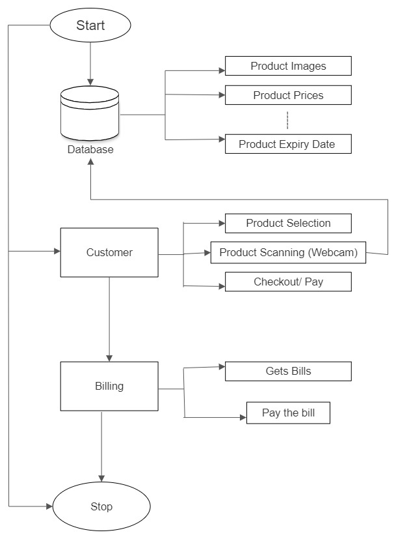
ARCHITECTURE

Slide 11
MODULES
5 Modules are used
1: Login–Id: This module is made for the login of users
2: Apply taxes and commissions: This module is used to Set the taxes for the products and commissions for the products.
3: Check the Report: This module is used to check the report of the product and how many products are sold in a period of time.
4: Enter the information about products: This module is used by data entry operator to enter the products cost, expiry and other information.
5: Calculate the bill: This module is used by bill calculating operator to Calculate the bill and Print it.

Slide 12
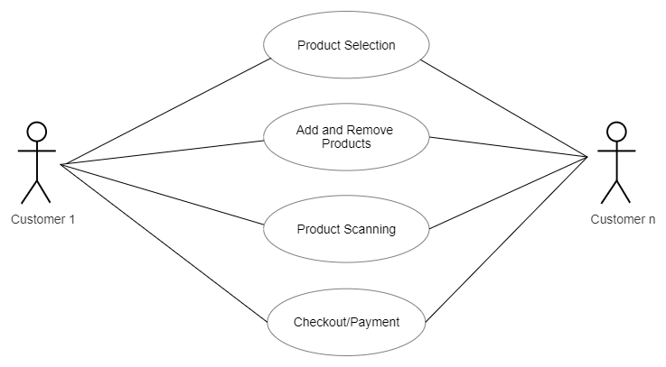
USE CASE DIAGRAM

Slide 13
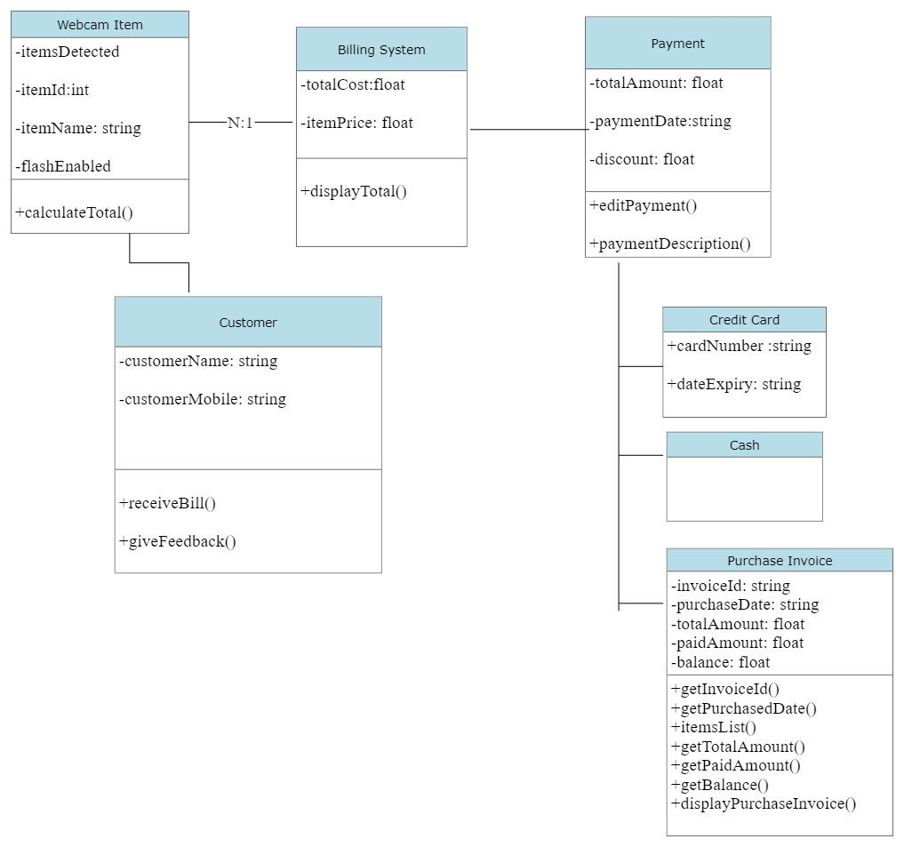
CLASS DIAGRAM

Slide 14
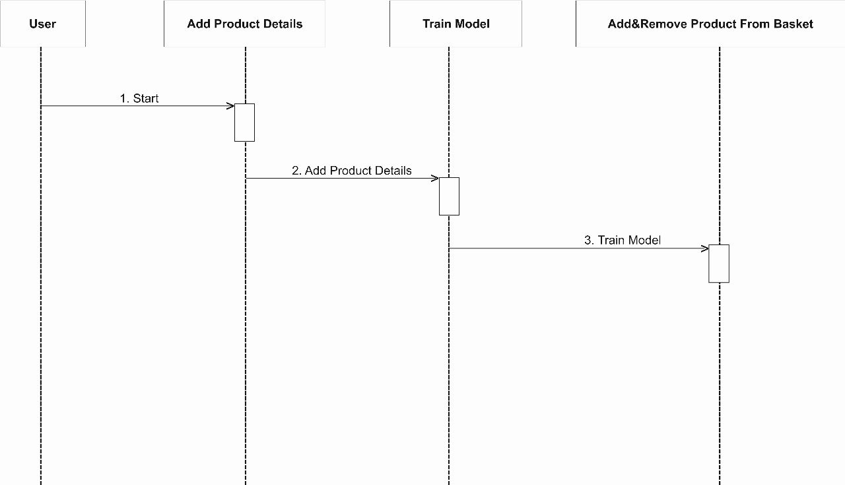
SEQUENCE DIAGRAM

Slide 15
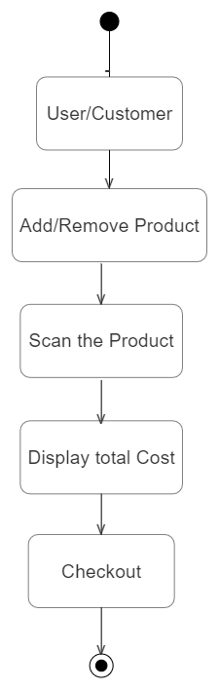
ACTIVITY DIAGRAM

Slide 16
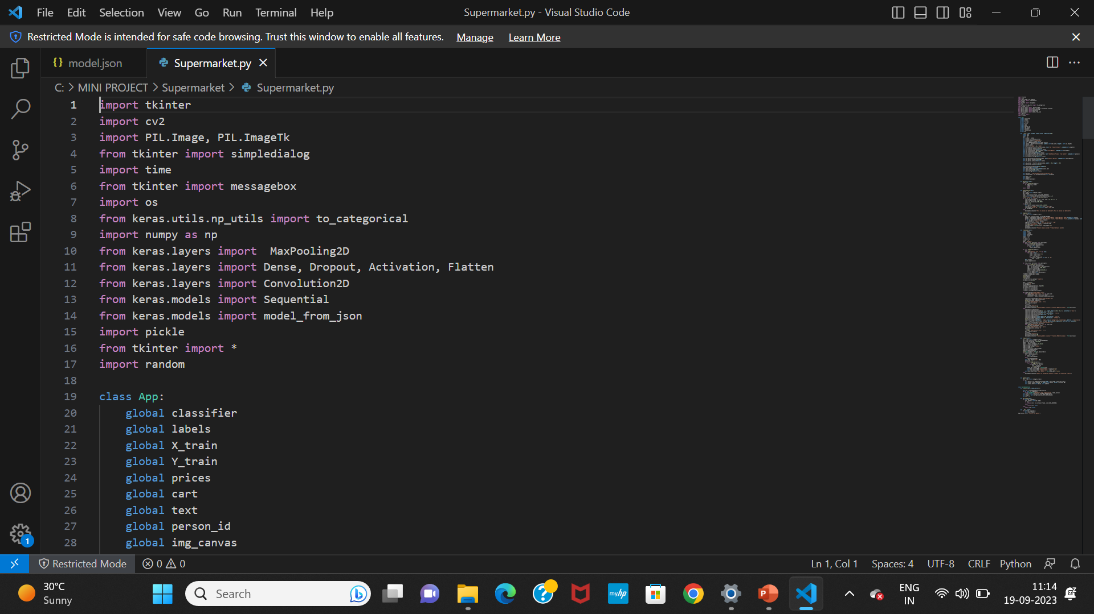
SAMPLE CODE

Slide 17
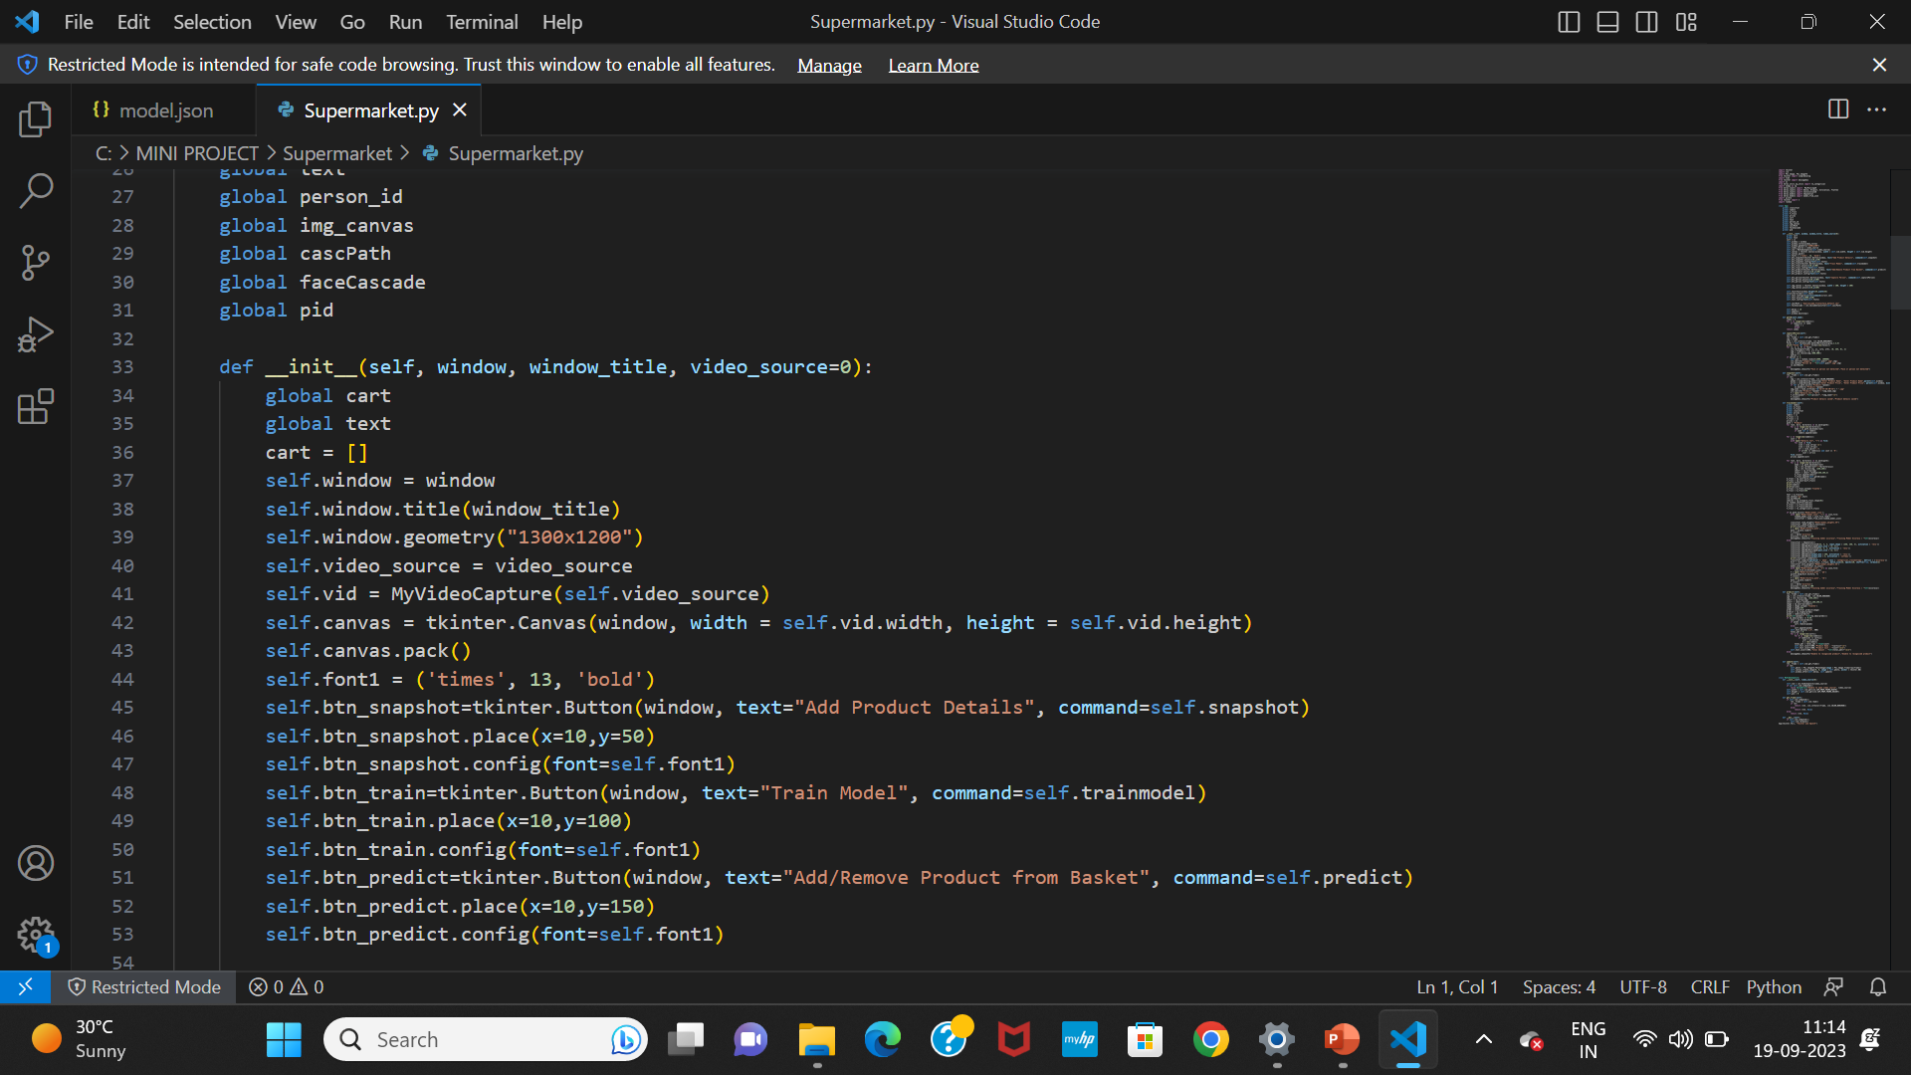

Slide 18
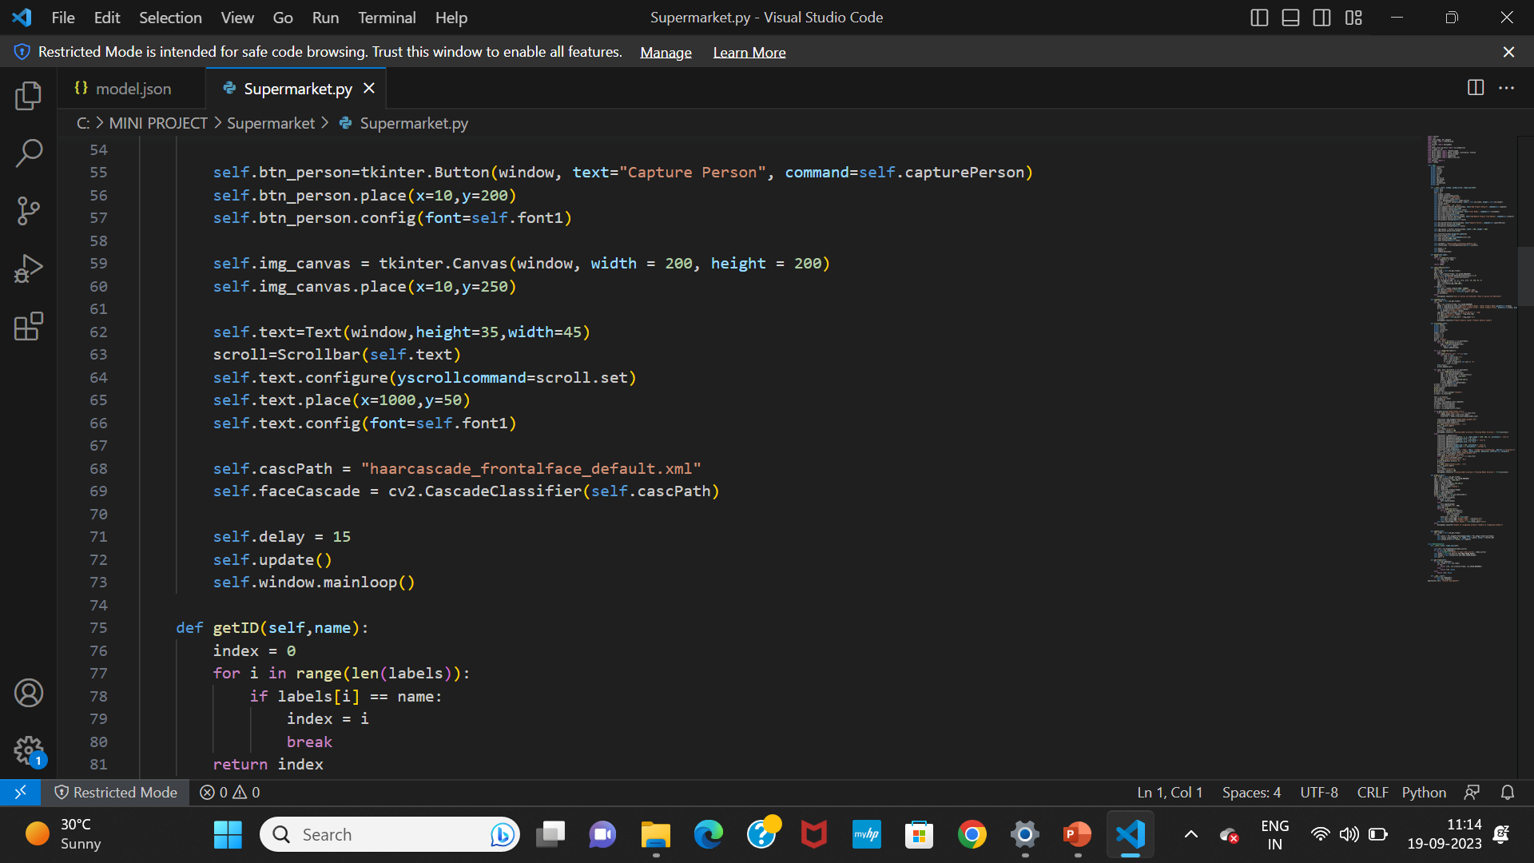

Slide 19
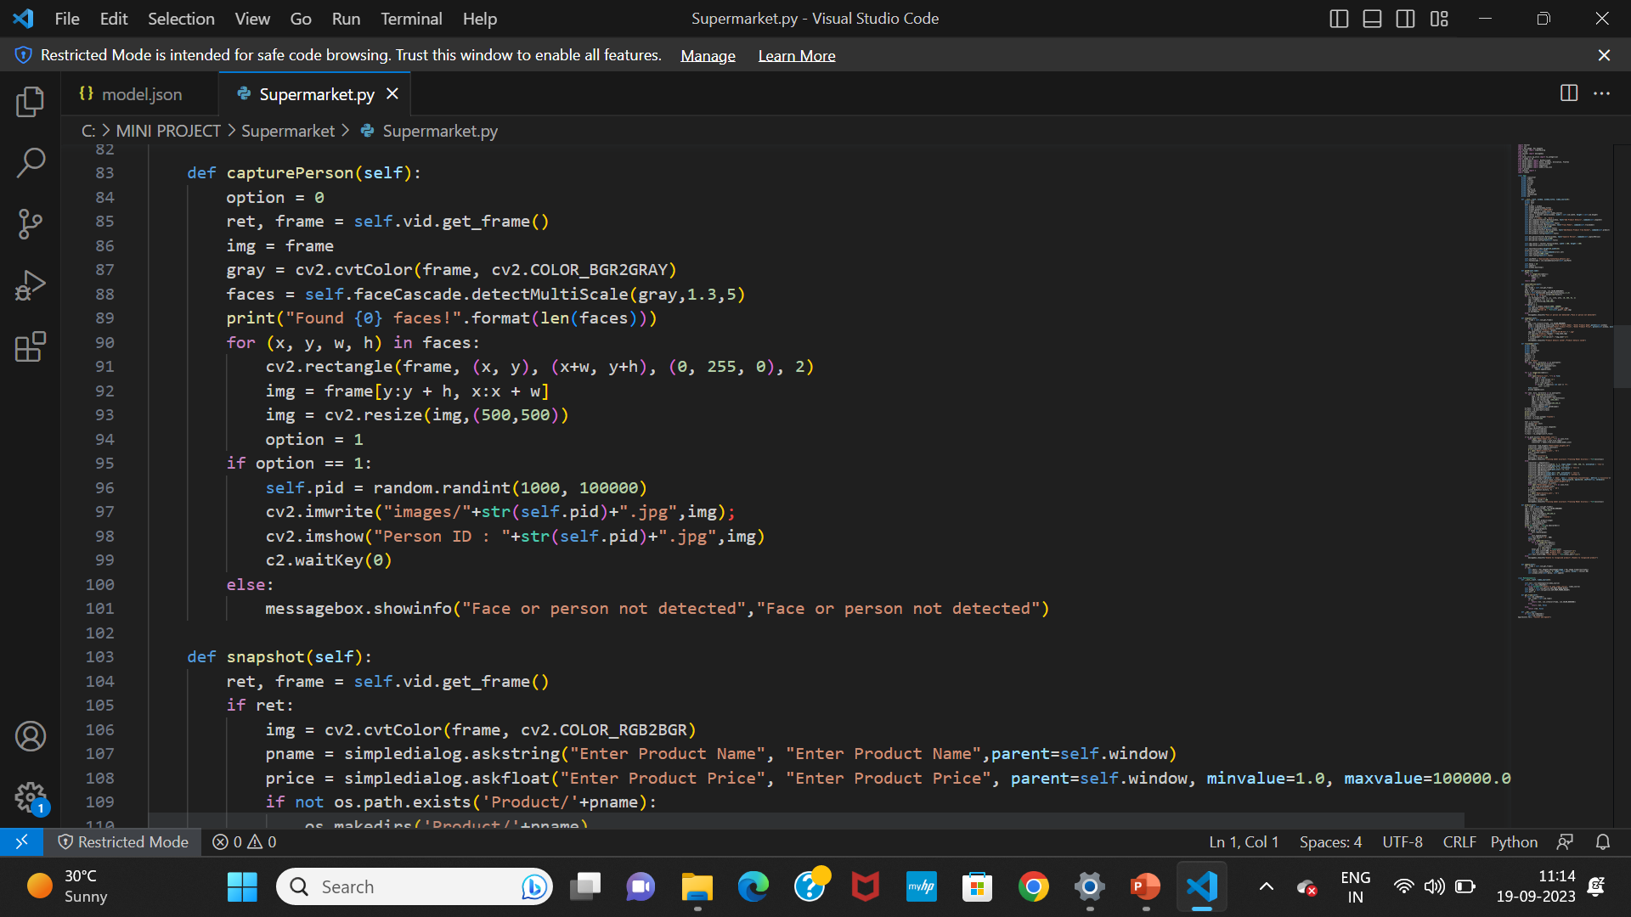

Slide 20
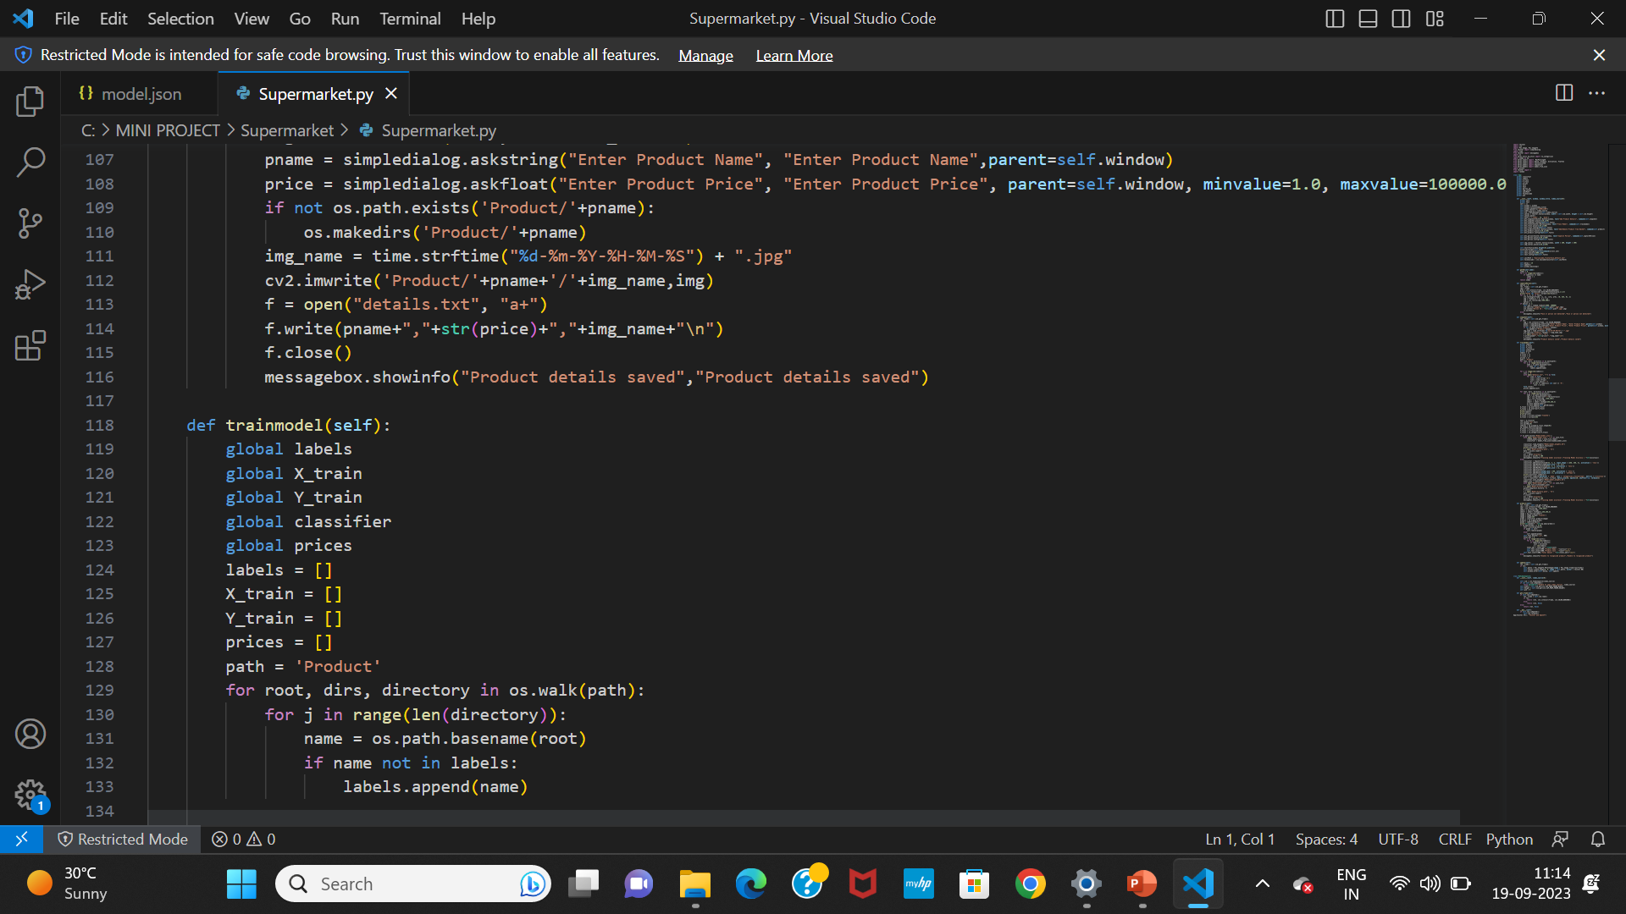

Slide 21
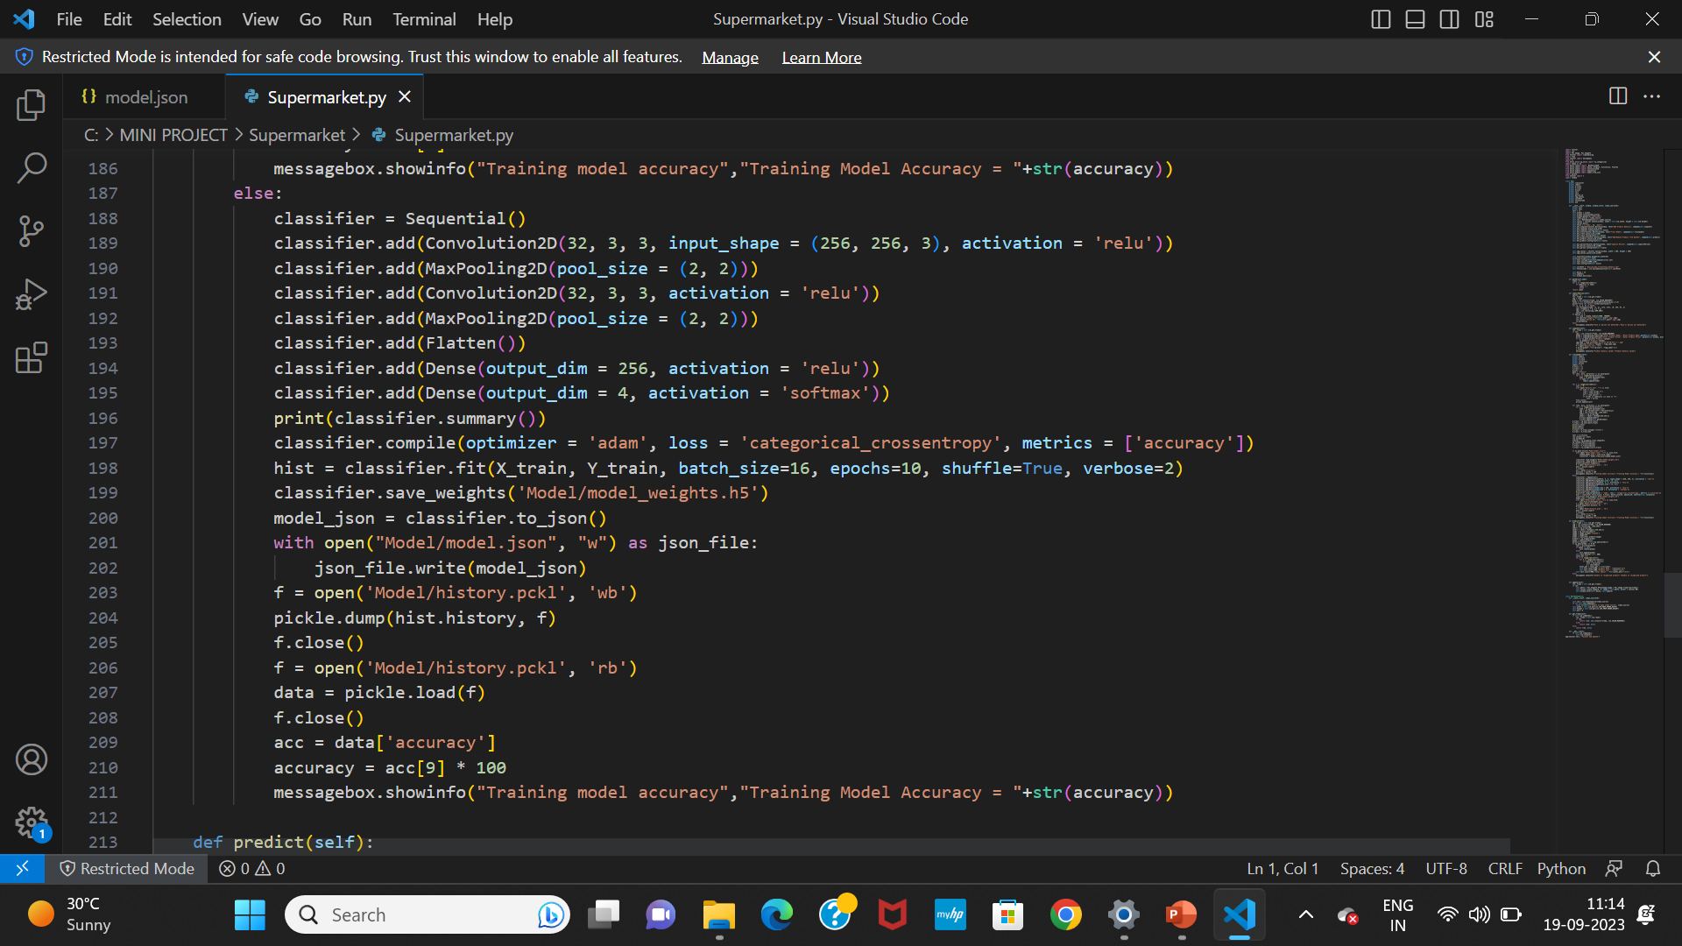

Slide 23
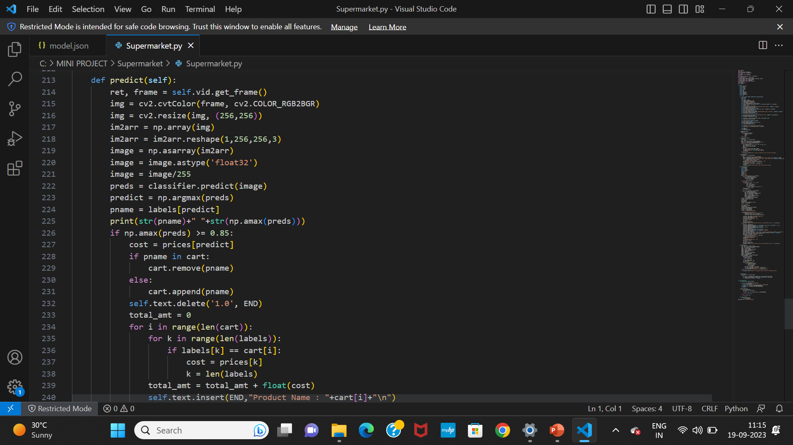

Slide 24
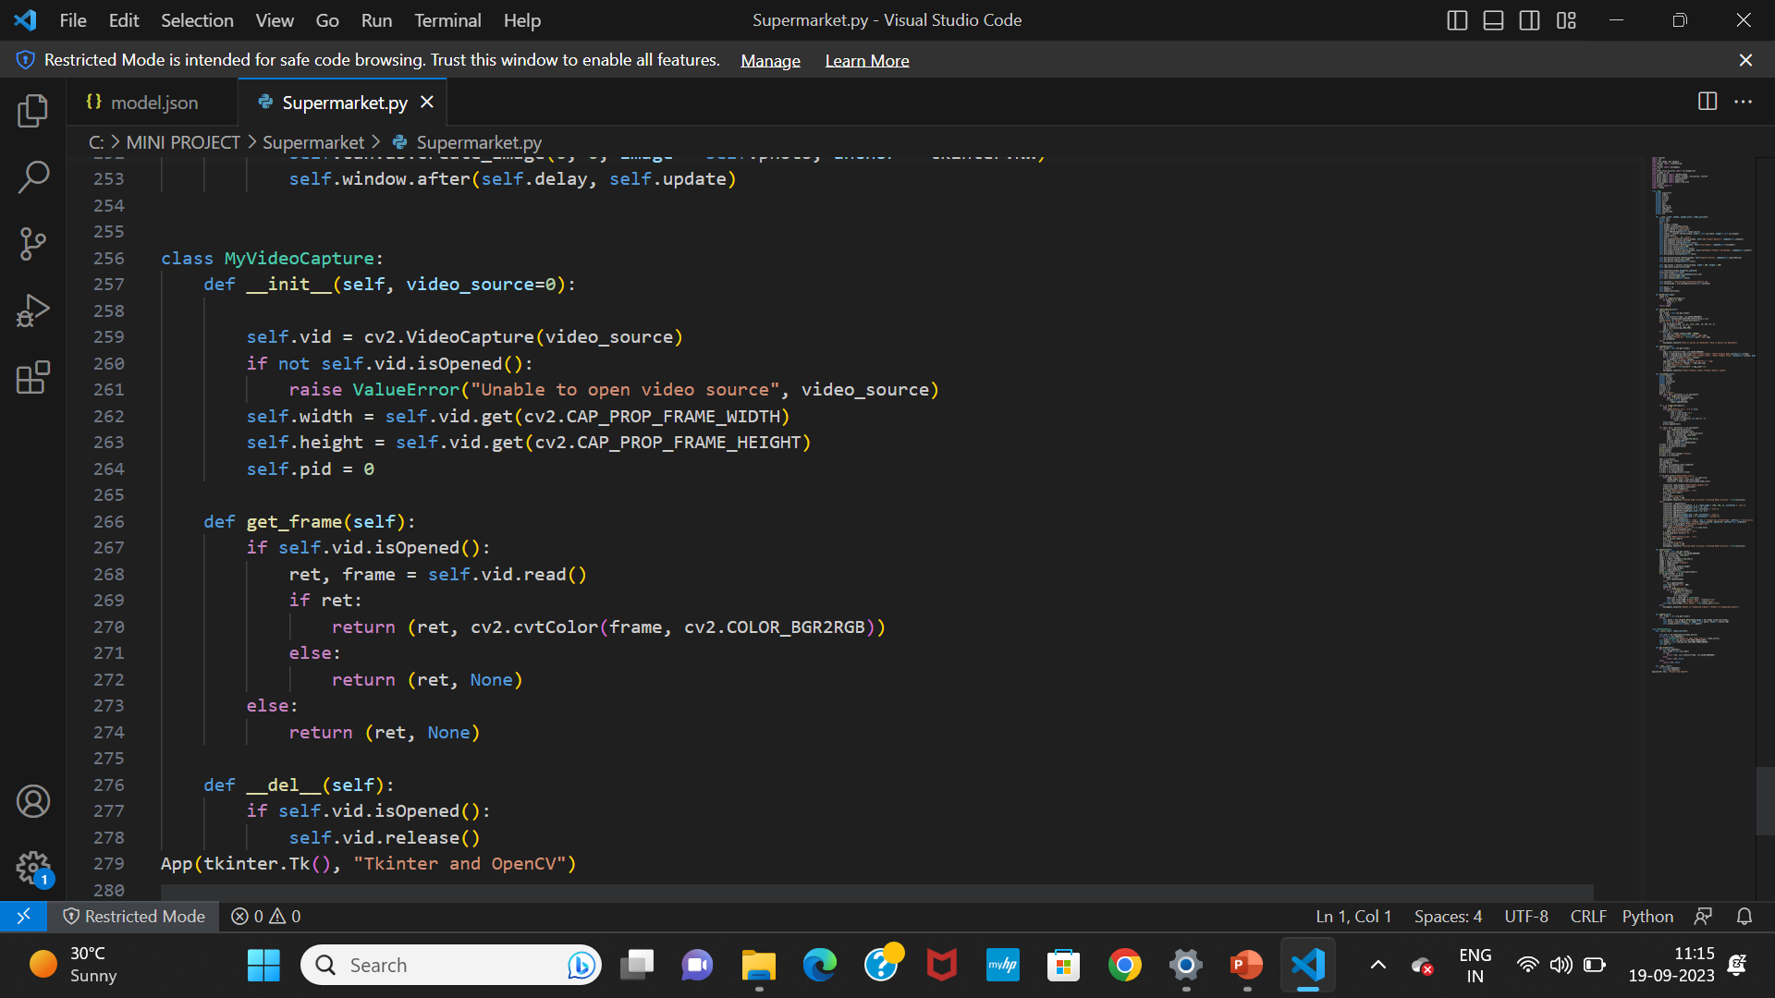

Slide 25
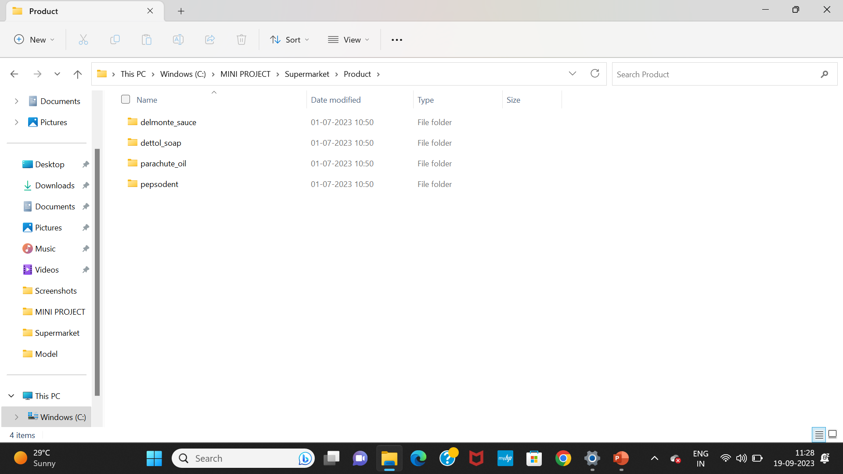
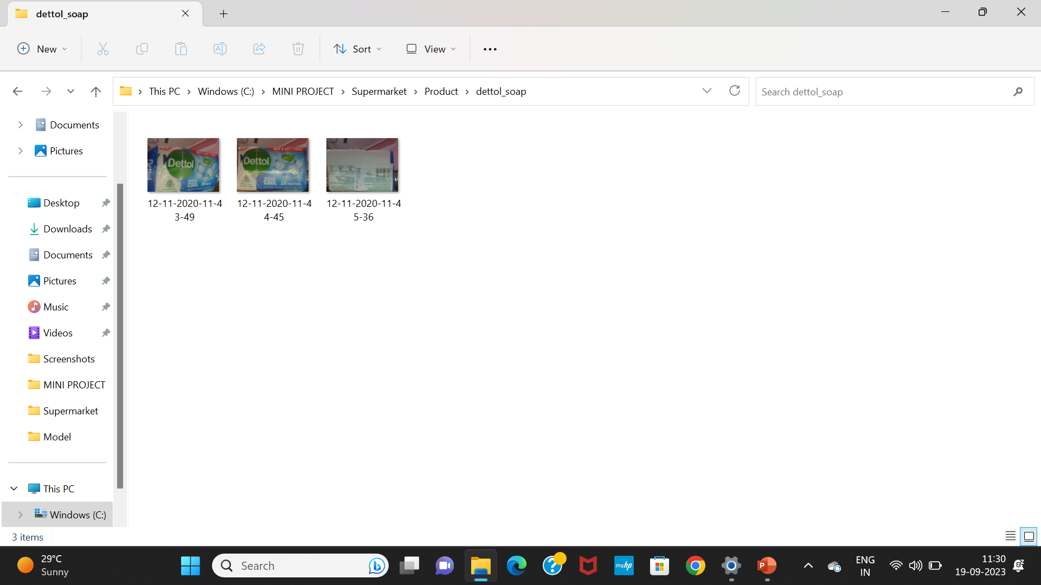
RESULT

Slide 26
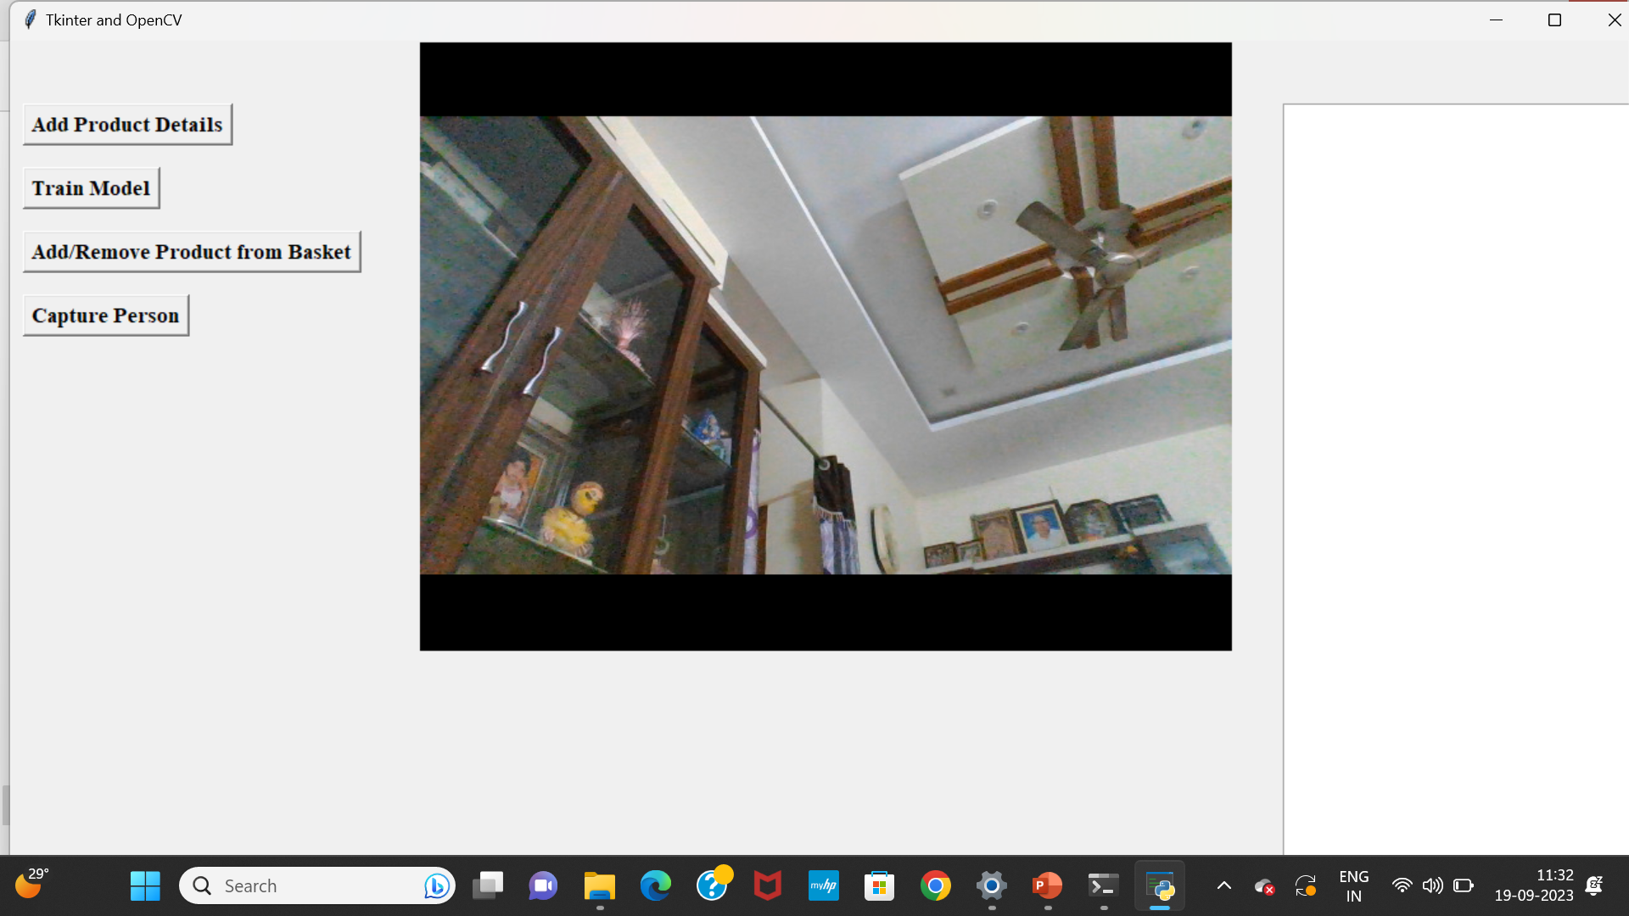
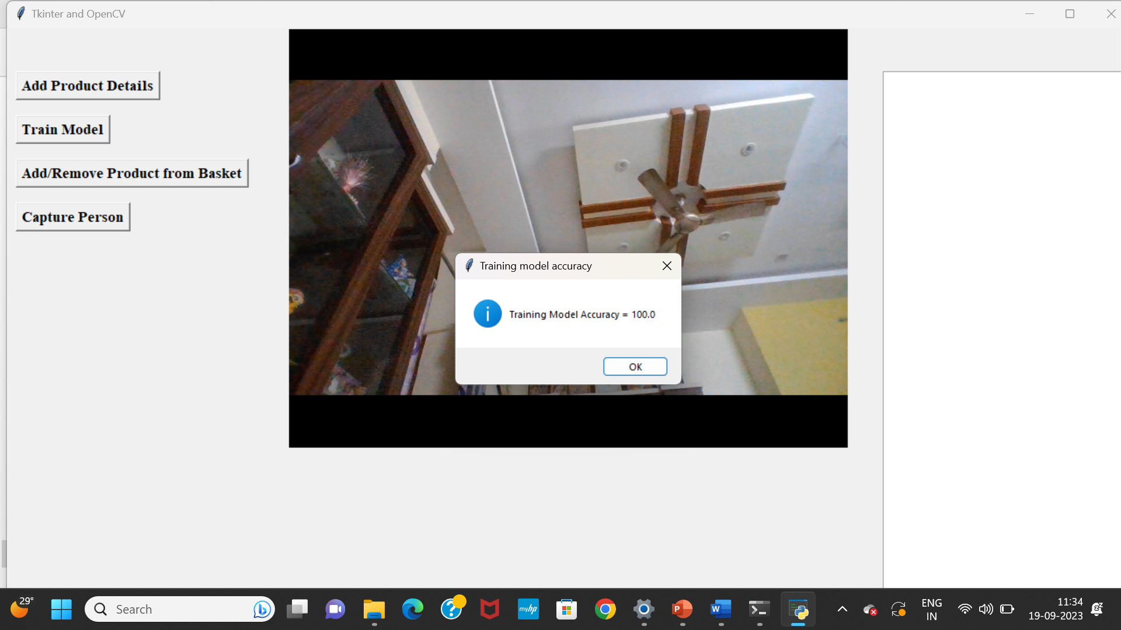

Slide 27
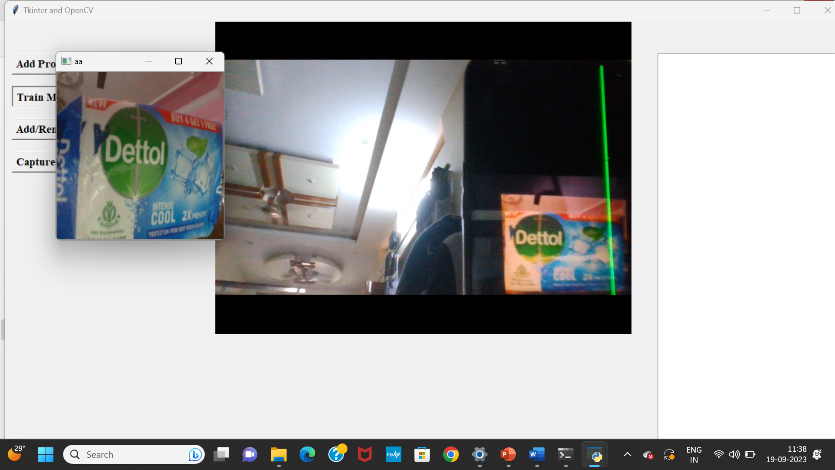
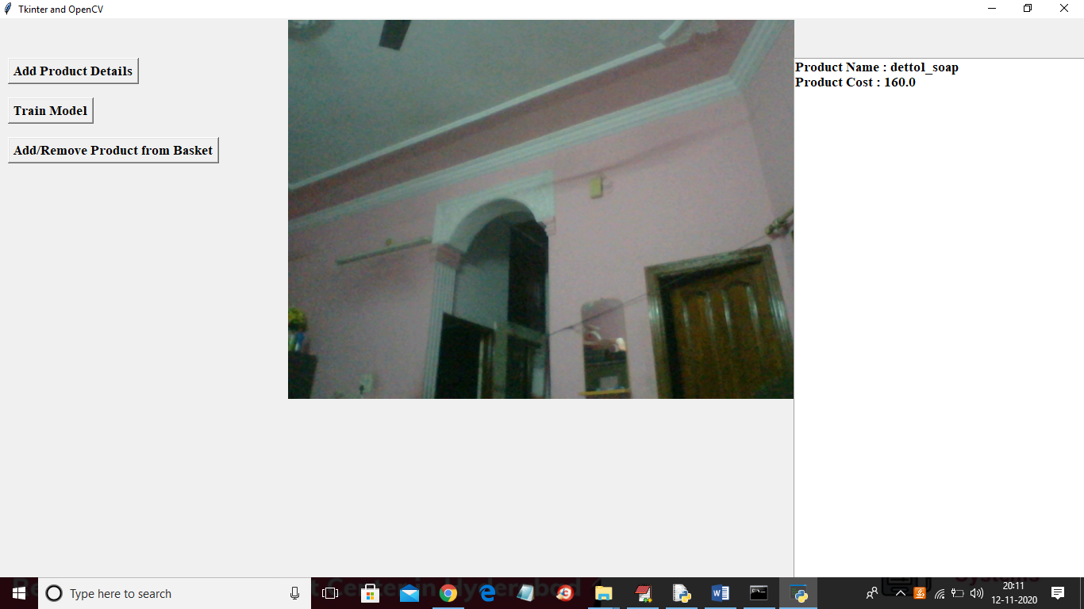

Slide 28

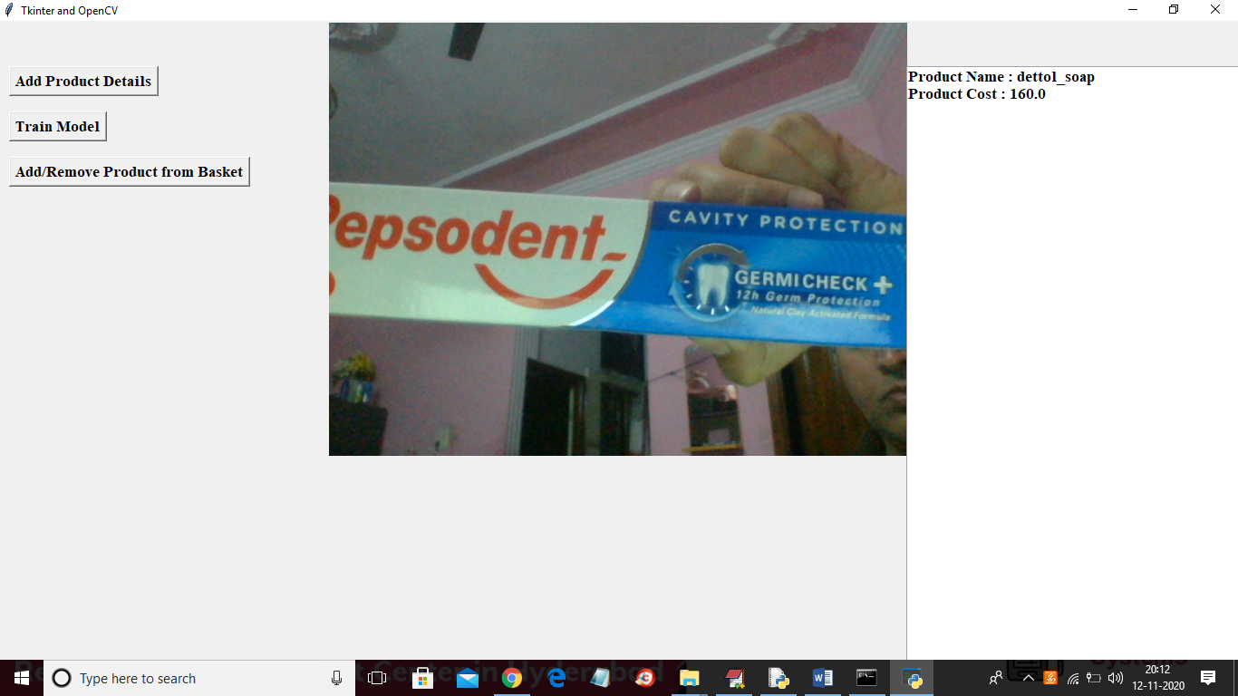

Slide 29
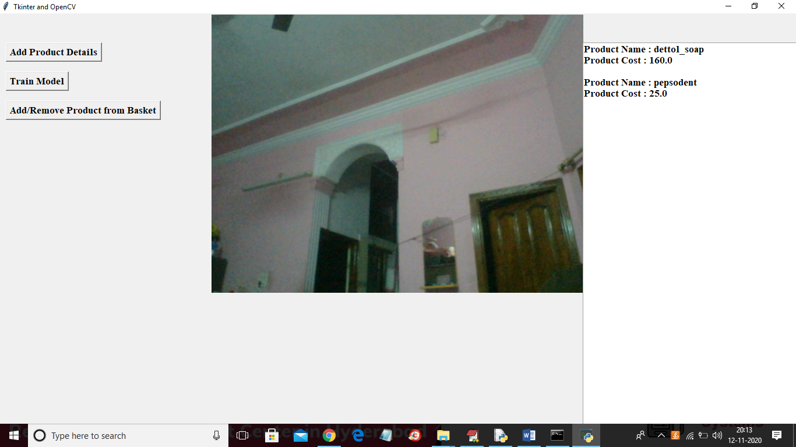
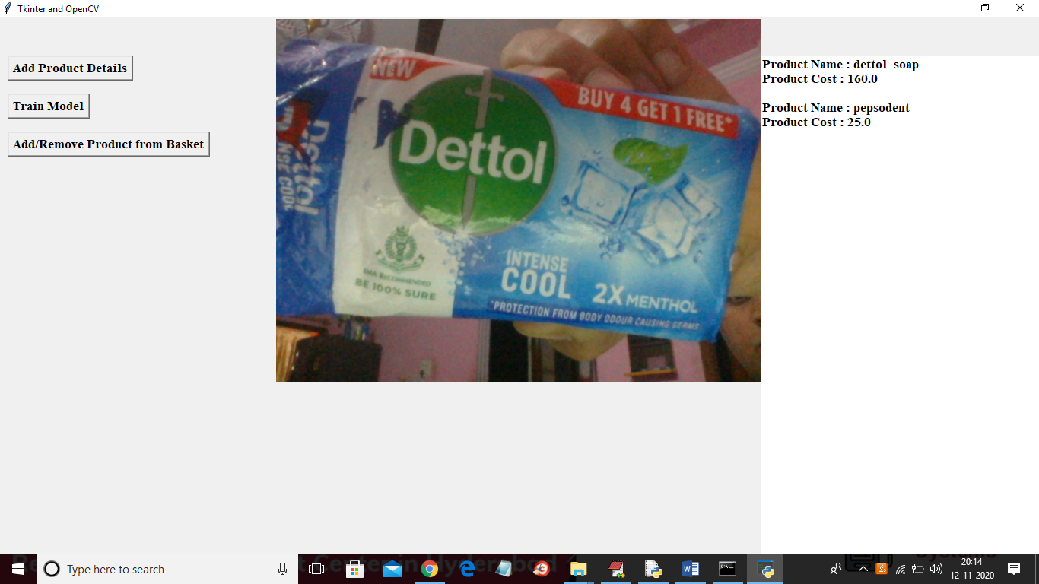

Slide 30
CONCLUSION
A Supermarket billing system using a webcam is a promising solution that has the potential to revolutionize the checkout process by improving efficiency and reducing waiting time.
This system can accurately recognize and identify products without the need for manual barcode scanning.
It has the potential to benefit both supermarkets and customers.

Slide 31
FUTURE SCOPE
A supermarket billing system that utilizes a webcam presents several promising avenues for future development and innovation. One key area of focus is the integration of advanced AI and computer vision technologies. Continuously enhancing the accuracy and speed of item recognition, even when items are partially obscured or damaged, can lead to more efficient and reliable checkout processes.
Another compelling direction is the pursuit of checkout-free shopping experience. Supermarkets can work toward fully automated checkout systems, enabling customers to simply pick up items and exit the store without the need for traditional checkout counters.

Slide 32
REFERENCES
1] Atzori, L., Iera, A., & Morabito, G, “The internet of things: A survey,” Computer Networks, vol.54, no. 15, 2010, pp. 2787–2805
[2] Gorbunov Vladimir(&) , Ionov Evgen(&) , and Naing Lin Aung \" Automatic Detection & classification of weaving fabric defects based on digital image processing.\" Second International Conference on green computing (2019).
[3] Zhang, Yanan, H. Wang, and F. Xu. \"Object detection and recognition of intelligent service robot based on deep learning.\" IEEE International Conference on Cybernetics and Intelligent Systems IEEE, 2018.
[4] Oliveira, Bernardo A. G. De, F. Magalhaes, and C. A. P. D. S. Martins. \"Fast and Lightweight Object Detection Network: Detection and recognition on resource constrained devices.\"
[5] Gerardus Blokdyk “Object Detection:A Complete Guide” 2020 Edition.

Slide 33
GITHUB LINK
https://github.com/207r1a05j6/Supermarket-Billing-System-Using-Webcam

Slide 34
THANK YOU!

